Slide 1
Preprocessing for SNU_AO Class
Yoonsoo P. Bach

Slide 2
Contents
Bias, Dark, Flat
Data from TRIPOL@SNU (2019-11-08 by Yoonsoo P. Bach)
Concept of

Slide 3
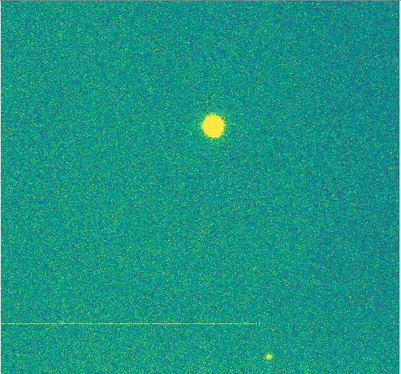
Preprocessing
Some processing that must be done prior to any further reduction
Reduction: e.g., 10 GB of obs files → 1 kB of magnitude info.
Commercial photos in smart phones:
Tab shutter
Takes 1000 frames (CMOS, not CCD)
Neural network chip: find features, exaggerate faces, outfocus background, …
Apply appropriate filters
Save it as jpg, heic, etc.
In professional astronomy:
Raw pixel values must be remained

Slide 4

Preprocessing
Some processing that must be done prior to any further reduction
Reduction: e.g., 10 GB of obs files → 1 kB of magnitude info.
Commercial photos in smart phones:
Tab shutter
Takes 1000 frames (CMOS, not CCD)
Neural network chip: find features, exaggerate faces, outfocus background, …
Apply appropriate filters
Save it as jpg, heic, etc.
In professional astronomy:
Raw pixel values must be remained
Cosmetic filters are not allowed for quantitative analysis!

Slide 5
Bias
0-sec exposure
shutter-closed
(IMAGETYP = 'Dark Frame')

Slide 6
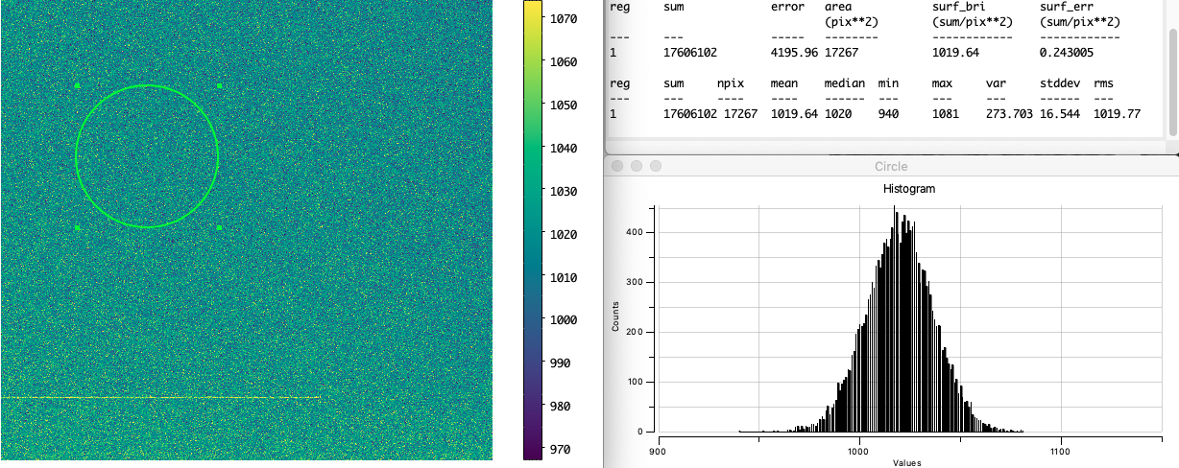
Bias
0-sec exposure
shutter-closed
(IMAGETYP = 'Dark Frame')
Bias
mean = 1019.6
med = 1020.0
std = 16.5

Slide 7
Bias
0-sec exposure
shutter-closed
(IMAGETYP = 'Dark Frame')
Bias
mean = 1019.6
med = 1020.0
std = 16.5
Noise source: Readout noise (Gaussian)

Slide 8
Bias
0-sec exposure
shutter-closed
(IMAGETYP = 'Dark Frame')
Bias
mean = 1019.6
med = 1020.0
std = 16.5
Noise source: Readout noise (Gaussian)
σ ~ 16 ADU ~ 25 e
(gain ~ 1.5)

Slide 9
Bias
0-sec exposure
shutter-closed
(IMAGETYP = 'Dark Frame')
Note: Why do we have bias? (artificial addition of a const)
If no bias, RDNOISE cannot be determined. The graph will be cut-off near 0, because we don't use negative pixel values (we use16-bit uint due to the file size)
It may change over time, so make it larger (≫ 10 RDNOISE)
Max value = 65,535 (16-bit unit), while non-linearity begins ~ 40k, so large bias don't harm dynamic range.
Bias
mean = 1019.6
med = 1020.0
std = 16.5
Noise source: Readout noise (Gaussian)
σ ~ 16 ADU ~ 25 e
(gain ~ 1.5)

Slide 10
Dark
t-sec exposure
shutter-closed
(IMAGETYP = 'Dark Frame')

Slide 11
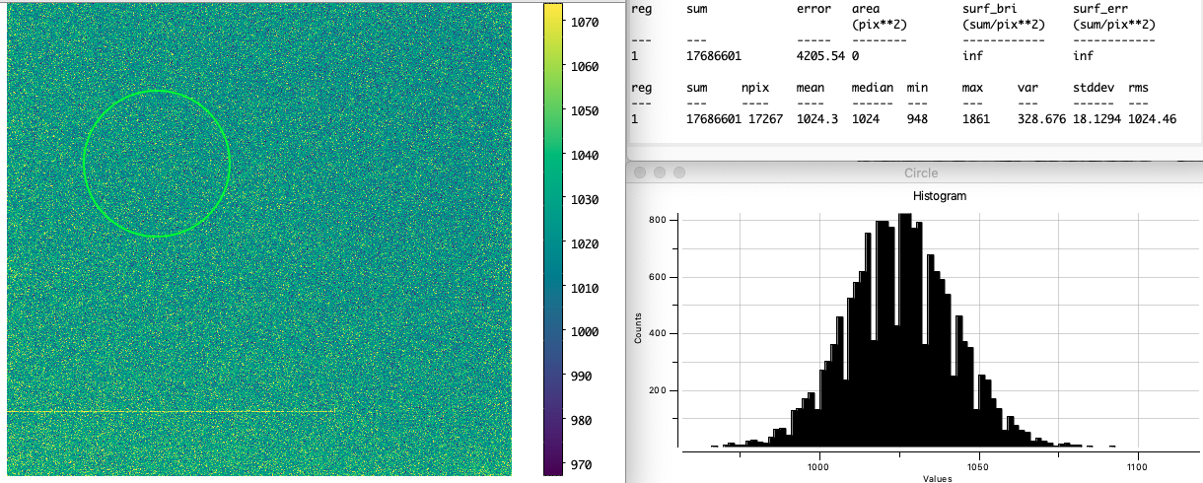
Dark
t-sec exposure
shutter-closed
(IMAGETYP = 'Dark Frame')
Dark 10 secs
mean = 1024.3
med = 1024.0
std = 18.1

Slide 12
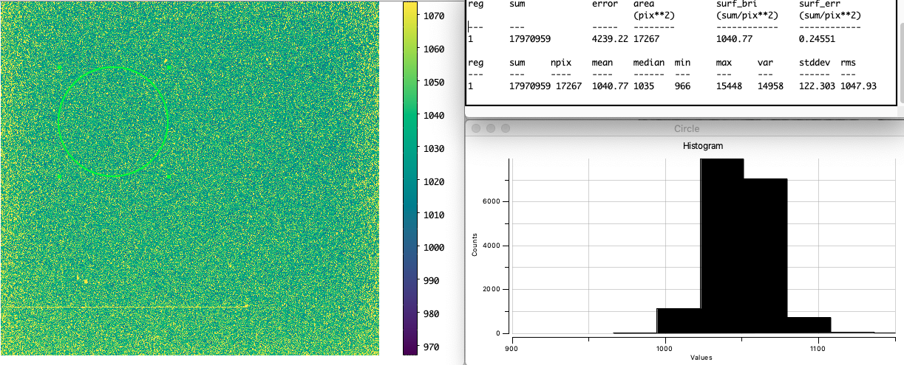
Dark
t-sec exposure
shutter-closed
(IMAGETYP = 'Dark Frame')
Dark 180 secs
mean = 1040.8
med = 1035.0
std = 122.3

Slide 13
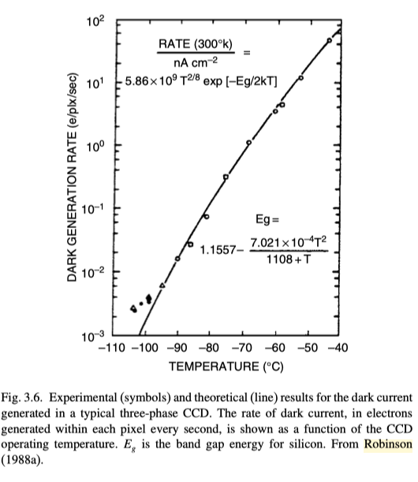
Dark
Dark appears due to electron thermal motion
bound e⁻'s in the semiconductor is freed probabilistically.
Many mechanisms for dark current generation. One is:
N ∝ T^{1.5}e^{-E/2kT} (See, e.g., Sect. 8.2 of McLean "Electronic Imaging in Astronomy" 2e)
T = temperature [K]
E = E(T) ~ a – bT²/(c + T) = Bandgap energy
At fixed T, N ∝ EXPTIME
From HowellSB 2006 "Handbook of CCD Astronomy" 2e

Slide 14
Dark
Dark appears due to electron thermal motion
bound e⁻'s in the semiconductor is freed probabilistically.
Many mechanisms for dark current generation. One is:
N ∝ T^{1.5}e^{-E/2kT} (See, e.g., Sect. 8.2 of McLean "Electronic Imaging in Astronomy" 2e)
T = temperature [K]
E = E(T) ~ a – bT²/(c + T) = Bandgap energy
At fixed T, N ∝ EXPTIME
N (bias + dark)
dark [ADU/s]
y ~ 0.0647 t +1023.35
(180, 1035)
(10, 1024)
From HowellSB 2006 "Handbook of CCD Astronomy" 2e
EXPTIME

Slide 15
Dark
Dark appears due to electron thermal motion
bound e⁻'s in the semiconductor is freed probabilistically.
Many mechanisms for dark current generation. One is:
N ∝ T^{1.5}e^{-E/2kT} (See, e.g., Sect. 8.2 of McLean "Electronic Imaging in Astronomy" 2e)
T = temperature [K]
E = E(T) ~ a – bT²/(c + T) = Bandgap energy
At fixed T, N ∝ EXPTIME
From HowellSB 2006 "Handbook of CCD Astronomy" 2e

Slide 16
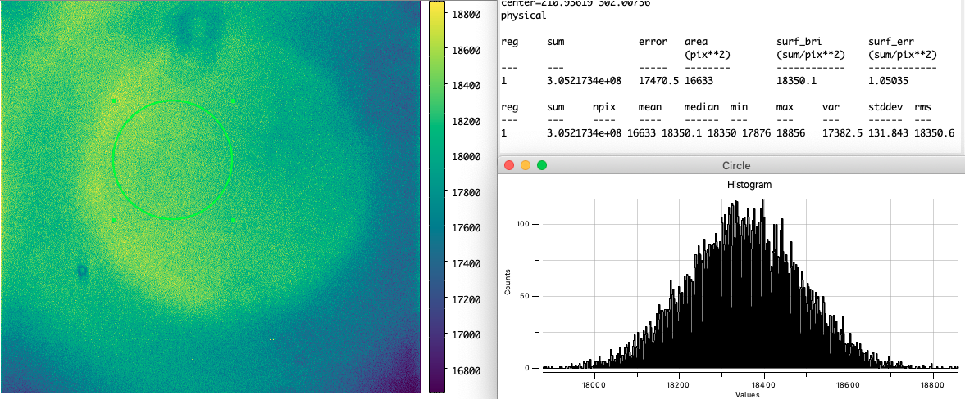
Flat
Dome flat
EXPTIME such that pixel count ~ 20k
IMAGETYP = 'Light Frame'
Dome Flat 2 sec

Slide 17
Flat
Note:
Exposure time : such that pixel count ≲ 30k (due to linearity)
Object must be as flat as possible. If not, skyflat needed.
Dome flat
EXPTIME such that pixel count ~ 20k
IMAGETYP = 'Light Frame'
Dome Flat 2 sec
Radial vignetting: expected feature
Donut: expected feature

Slide 18
Flat
Dome flat may have "true gradient", which may also appear in the flat FITS file.
We then need skyflat (very flat, homogeneous source) for "illumination" correction.
SNU Observatory (Bldg. 46)

Slide 19

Preprocessing
$N=\left(I+S+C\right)F+D+B$
N = what we observed
I = Real signal from source
S = sky
C = cosmic ray
F = flat (sensitivity + optics vignetting)
D = dark (electron thermal motion – EXPTIME-dependent)
B = bias (artifically added constant)

Slide 20
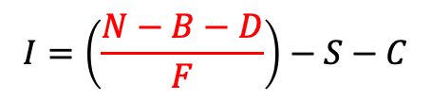
Preprocessing
$$I=\left(\frac{N−B−D}{F}\right)−S−C$$
Preprocessing
$N=\left(I+S+C\right)F+D+B$
N = what we observed
I = Real signal from source
S = sky
C = cosmic ray
F = flat (sensitivity + optics vignetting)
D = dark (electron thermal motion – EXPTIME-dependent)
B = bias (artifically added constant)

Slide 21
Preprocessing
$$I=\left(\frac{N−B−D}{F}\right)−S−C$$
Preprocessing
Prepare Bias
Subtract "master" bias
master bias = combine multiple biases
Prepare Dark
Subtract bias from all dark frames, such that only pure dark current is left.
Make "master" dark for each exposure time.
Scale it such that the dark of EXPTIME of our object is made.
If you already have dark of EXPTIME identical to our object, scaling is not needed.
Prepare Flat
Subtract bias and dark from all flat frames, such that only pure flat pattern is left.
Make "master" flat for each optics configuration (filter, etc)
Normalize the master flat so that, e.g., mean = 1

Slide 22
Preprocessing
$$I=\left(\frac{N−B−D}{F}\right)−S−C$$
Preprocessing
Bias Subtraction
Image_BXX = Image (N) – bias (B)
Dark Subtraction
Image_BDX = Image_BXX – bias_subtracted_dark (D)
Flat Fielding
Image_BDF = Image_BDX / normalized_flat (F)

Slide 23
Preprocessing
$$I=\left(\frac{N−B−D}{F}\right)−S−C$$
Preprocessing
Bias Subtraction
Image_BXX = Image (N) – bias (B)
Dark Subtraction
Image_BDX = Image_BXX – bias_subtracted_dark (D)
Flat Fielding
Image_BDF = Image_BDX / normalized_flat (F)
Why don't we just subtract original dark? Bias subtraction for dark looks redundant.
Statistical error analysis requires pure dark currents, because dark follows Poisson. For proper error-analysis, pure dark value is essential.
Sometimes we cannot take darks all the time (e.g., 30-min exposure of object → 10 dark means 5 hours of dark!!!). Then we either (1) ignore dark or (2) scale from, e.g., 3-min dark.

Slide 24
TIP: Illumination Correction
What if your flat is not "flat" and shows large-scale structure?
Take blank sky
Do all preprocessing to it (including flat)
Smooth it
This will show the large-scale pattern in the flat.
Multiply it to the original flat (illumination correction).
Use this illumination corrected flat for future flat correction.
References
IRAF.noao.imred.ccdred.flatfields: http://iraf.noao.edu/scripts/irafhelp?flatfields
ESO MIDAS User's Guide : http://www.eso.org/sci/software/esomidas/doc/
See Vol B "Additional Processing" : http://www.eso.org/sci/software/esomidas/doc/user/18NOV/volb/node55.html

